Slide 1
Chapter 3: Introduction to SQL

Slide 2
Nested Subqueries
SQL provides a mechanism for the nesting of subqueries. A subquery is a select-from-where expression that is nested within another query.
The nesting can be done in the following SQL query select A₁, A₂, ..., A_{n} from r₁, r₂, ..., r_{m} where P
as follows:
From clause: r_{i} can be replaced by any valid subquery
Where clause: P can be replaced with an expression of the form:
B <operation> (subquery)
B is an attribute and <operation> to be defined later.
Select clause:
A_{i} can be replaced be a subquery that generates a single value.

Slide 3
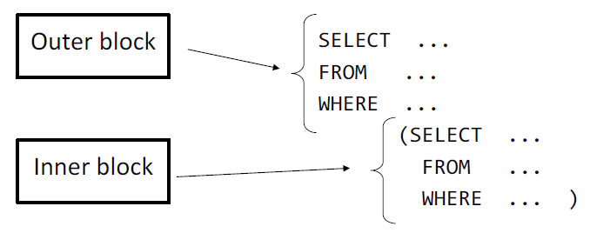
Nested Subqueries

Slide 4
Subqueries in the Select Clause

Slide 5
Scalar Subquery
Scalar subquery is one which is used where a single value is expected
List all departments along with the number of instructors in each department
select dept_name, ( select count(*) from instructor where department.dept_name = instructor.dept_name) as num_instructors from department;
Runtime error if subquery returns more than one result tuple

Slide 6



Scalar Subquery
Obtenga las definitivas del curso de cada uno de los estudiantes. Liste el nombre y apellido del estudiante y la sumatoria de puntos de todos los ejercicios (la definitiva del curso). En el resultado no aparece el sid 104
SELECT
s.first,
s.last,
SUM(r.points) as definitiva
FROM
results r,
students s
WHERE
s.sid = r.sid
GROUP BY
s.first,
s.last;
SELECT
s.first, s.last,
(
SELECT
SUM(points)
FROM
results r
WHERE
r.sid = s.sid
) AS definitiva
FROM
students s
SELECT
s.first, s.last,
nvl((
SELECT
SUM(points)
FROM
results r
WHERE
r.sid = s.sid
),0) AS definitiva
FROM
students s

Slide 7
Subqueries in the From Clause

Slide 8
Subqueries in the Form Clause
SQL allows a subquery expression to be used in the from clause
Find the average instructors’ salaries of those departments where the average salary is greater than $42,000.”
select dept_name, avg_salary from ( select dept_name, avg (salary) as avg_salary from instructor group by dept_name) where avg_salary > 42000;
Note that we do not need to use the having clause
Another way to write above query
select dept_name, avg_salary from ( select dept_name, avg (salary) from instructor group by dept_name)
as dept_avg (dept_name, avg_salary)
where avg_salary > 42000;

Slide 9
With Clause
The with clause provides a way of defining a temporary relation whose definition is available only to the query in which the with clause occurs.
Find all departments with the maximum budget with max_budget (value) as (select max(budget) from department) select department.name from department, max_budget where department.budget = max_budget.value;

Slide 10
Complex Queries using With Clause
Find all departments where the total salary is greater than the average of the total salary at all departments
with dept _total (dept_name, value) as
(select dept_name, sum(salary)
from instructor
group by dept_name),
dept_total_avg(value) as
(select avg(value)
from dept_total)
select dept_name
from dept_total, dept_total_avg
where dept_total.value > dept_total_avg.value;

Slide 11
Ejemplo Esquema Results
-- Liste el nombre del estudiante que tiene el mayor numero de puntos obtenidos
--1. calcular los puntos de cada estudiante (group by)
--2. en el query 1 claculo el mayor
--3. obtengo los estudiantes con el puntaje mayor del paso 2
--punto 1
with puntos_por_estudiante as
(
SELECT s.sid,SUM(r.points) as definitiva
FROM results r, students s
WHERE s.sid = r.sid GROUP BY s.sid
),
--punto 2
puntaje_mayor as(
select max(definitiva) as mayor from puntos_por_estudiante
)
--select * from puntaje_mayor;
--punto 3
select st.first, st.last, pe.definitiva
from students st, puntos_por_estudiante pe
where st.sid = pe.sid
and pe.definitiva = (select mayor from puntaje_mayor)

Slide 12
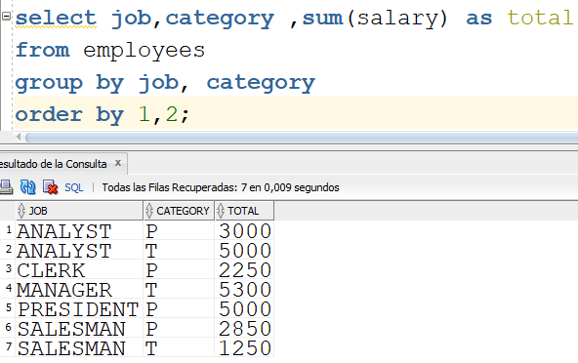
Ejemplo de Agregados con varias columnas
Liste el total de salarios por job y categoria
Notes:
select job,category ,sum(salary) as total
from employees
group by job, category
order by 1,2;

Slide 13
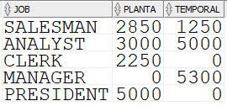
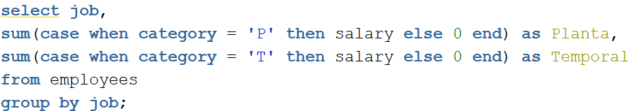
Ejemplo de CASE y SUM
Liste el total de salarios por job y categoría, pero de la siguiente manera:
Notes:
select job,
sum(case when category = 'P' then salary else 0 end) as Planta,
sum(case when category = 'T' then salary else 0 end) as Temporal
from employees
group by job;

Slide 14
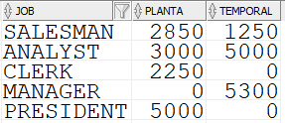
Ejemplo de CASE , SUM y totalice
Liste el total de salarios por job y categoría, ahora con fila de TOTALES:
select nvl(job,'Total') as job,
sum(case when category = 'P' then salary else 0 end) as Planta,
sum(case when category = 'T' then salary else 0 end) as Temporal
from employees
group by (job)
Notes:
select nvl(job,'Total') as job,
sum(case when category = 'P' then salary else 0 end) as Planta,
sum(case when category = 'T' then salary else 0 end) as Temporal
from employees
group by ROLLUP(job)

Slide 15
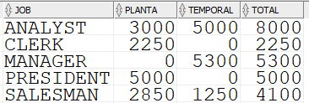
Subconsulta Query Externo
select job, planta, temporal, planta + temporal as total
from
(
select nvl(job,'Total') as job,
sum(case when category = 'P' then salary else 0 end) as Planta,
sum(case when category = 'T' then salary else 0 end) as Temporal
from employees
group by (job)
)
Notes:
select job, planta, temporal, planta + temporal as total
from
(
select nvl(job,'Total') as job,
sum(case when category = 'P' then salary else 0 end) as Planta,
sum(case when category = 'T' then salary else 0 end) as Temporal
from employees
group by rollup(job)
)

